Slide 1
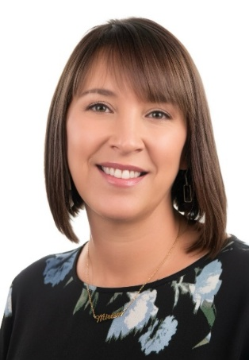
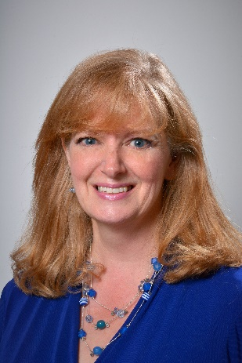
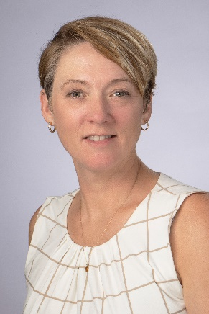
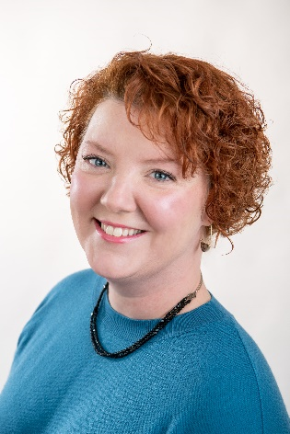


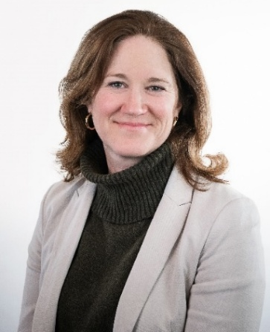
Did You Know?
FAME’s Education Affordability and Financial Wellness team supports families in every Maine county?
Mary Dyer
Education Affordability and Financial Wellness Manager
Mila Tappan
Education Affordability Content and Training Manager
Nikki Vachon
Jessica Whittier
Sydney McLean
Maire Pelletier
Karin Parsons
Education Affordability and Financial Wellness Counselors
Notes:
We are a small team serving the state. We are finding more out of state requests but aren’t able to meet them because we are stretched to fulfill needs of ME students. We do have free website resources and recorded sessions that anyone can use.

Slide 2


Did You Know?
FAME’s Education Affordability and Financial Wellness team includes a New Mainer and Financial Education Specialist?
Floreka Mananga
New Mainer Specialist
Steve Kautz
Financial Education Programs Specialist

Slide 3
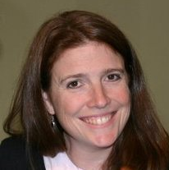
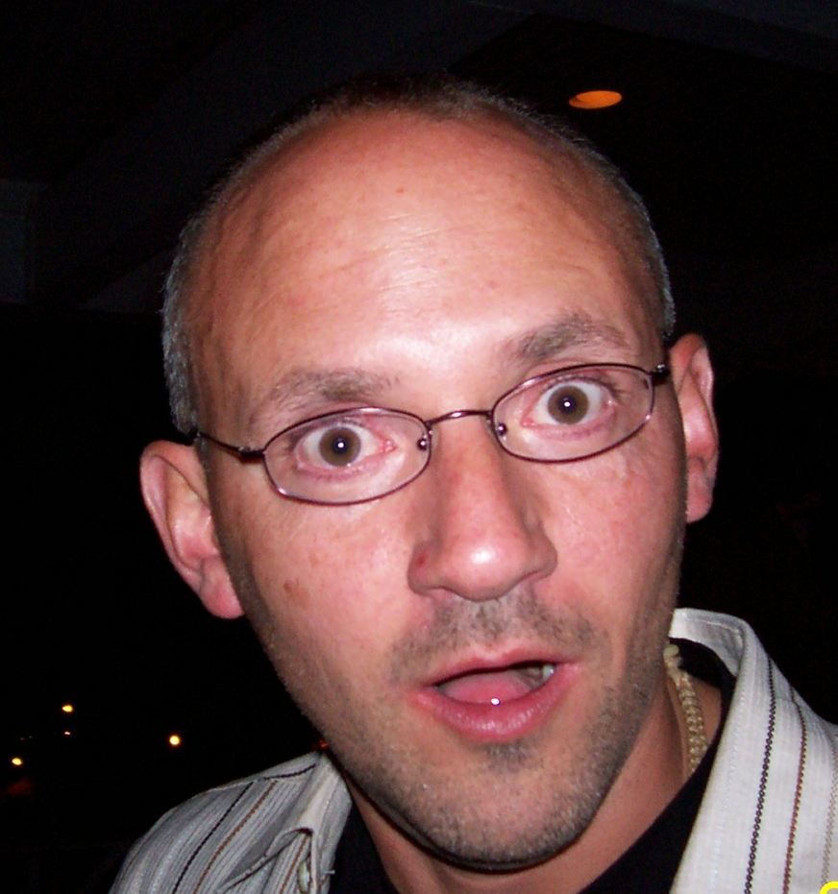

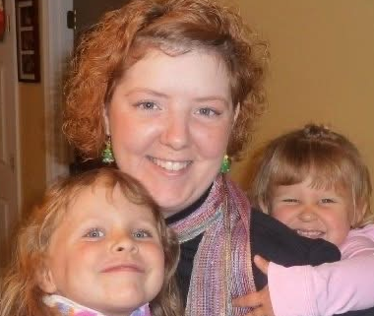

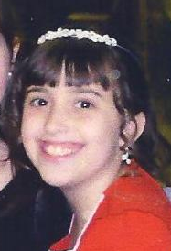
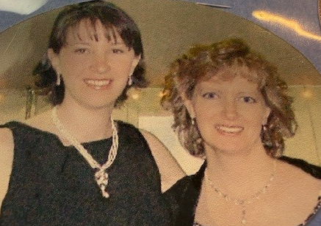
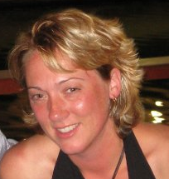
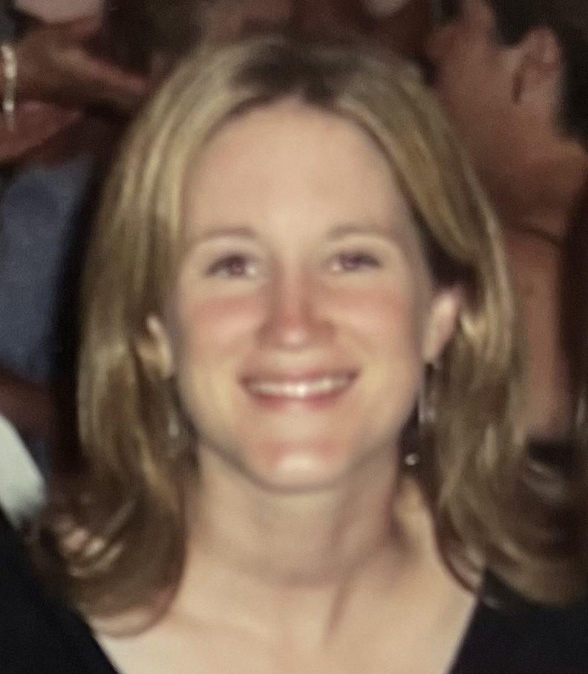

Did You Know?
This is FA EA 101’s 20th Anniversary?!
Martha Johnston
Steve Kautz
Diana Beaudoin
Jessica Whittier
Sydney McLean
FAME Staff Circa 2006
Maire Pelletier
Nikki Vachon
Mary Dyer & Mila Tappen
Jennifer Lanphear
Karin Parsons

Slide 4
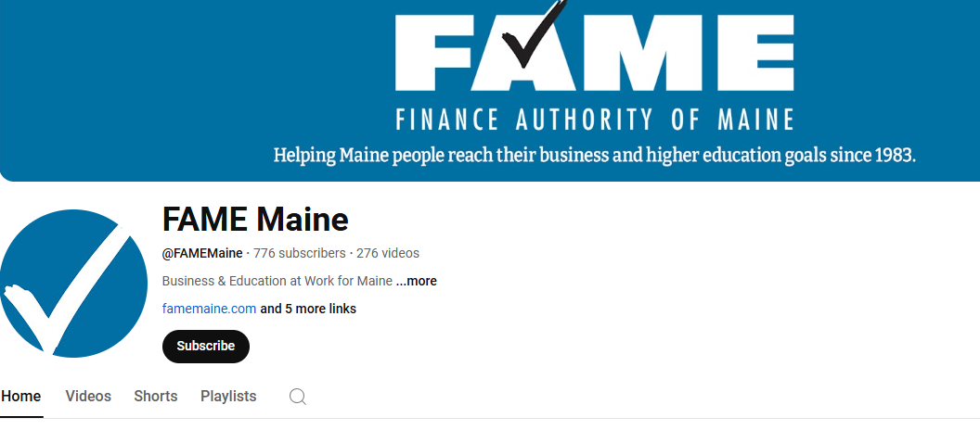
Did You Know?
FAME presentations can be found on our YouTube channel?
Notes:
Over 2k views

Slide 5
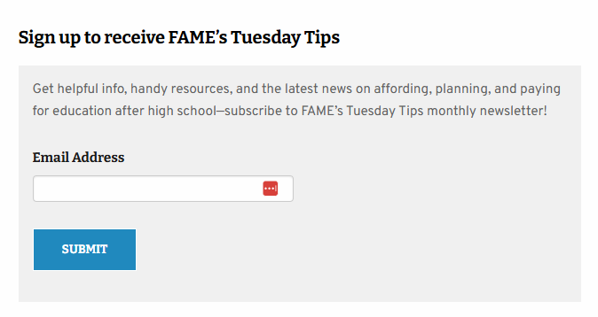
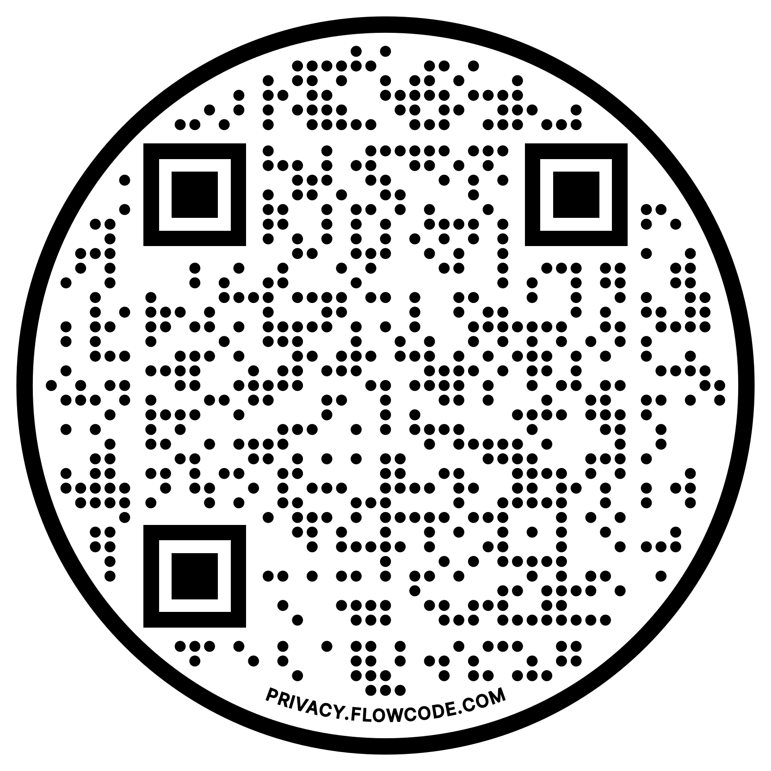
Did You Know?
That families can subscribe to Tuesday Tips and receive helpful resources and timely news?
Scan to Sign Up for Tuesday Tips
Notes:
https://www.famemaine.com/affording-education/tuesday-tips/
FAME’s Tuesday Tips newsletter is for anyone interested in education-related news, info, and resources on affording, planning, and paying for higher education.
Sent out the first Tuesday of the month – tied to the previous month’s Wednesday Webinar

Slide 6

Did You Know?
FAME offers FREE virtual financial aid training in the fall and throughout the year?

Slide 7
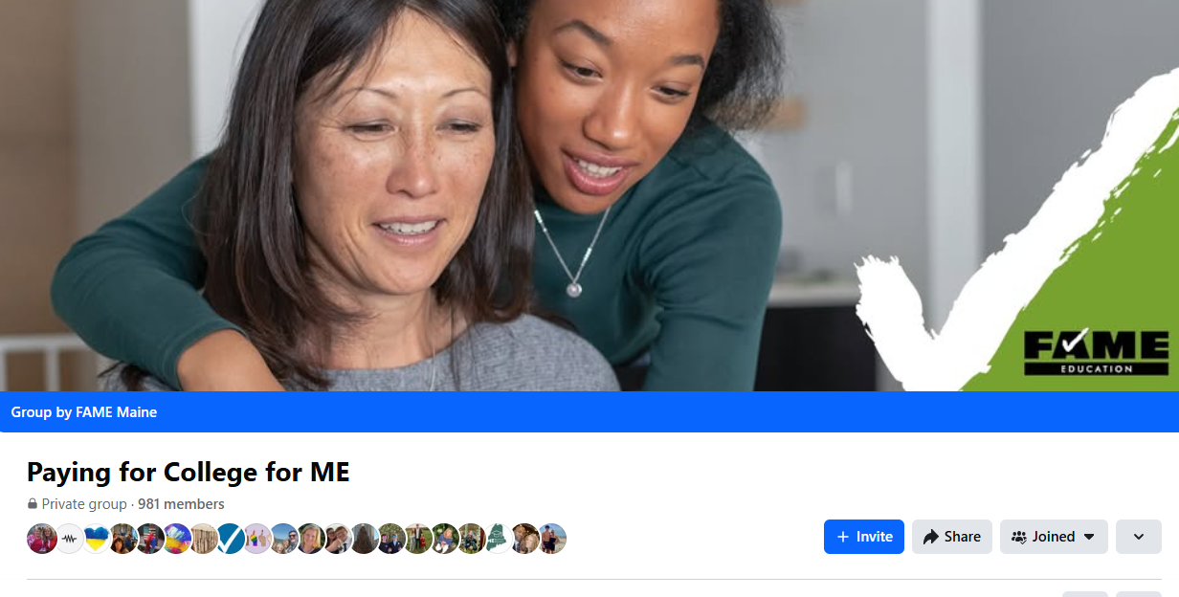
Did You Know?
FAME has a texting/email program for students and a Facebook group for parents/caregivers?
Notes:
https://www.facebook.com/groups/payingforcollegeme

Slide 8
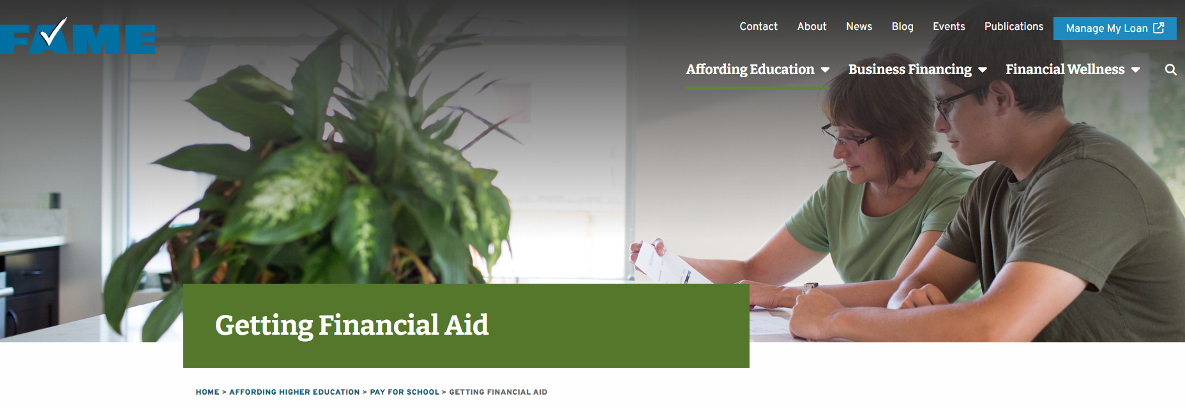
Did You Know?
FAME offers financial aid nights for juniors and comparing award offer sessions for seniors?
Upcoming State-Wide Virtual Financial Aid Nights
April 15th, 6:00pm
May 5th, 6:00pm
Register at https://www.famemaine.com/events/

Slide 9
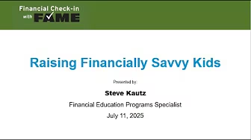

Did You Know?
FAME offers monthly webinar series that cover college savings, financial aid, and financial wellness?

Slide 10
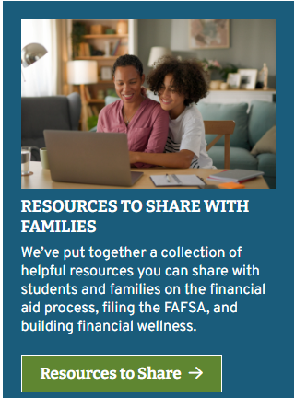
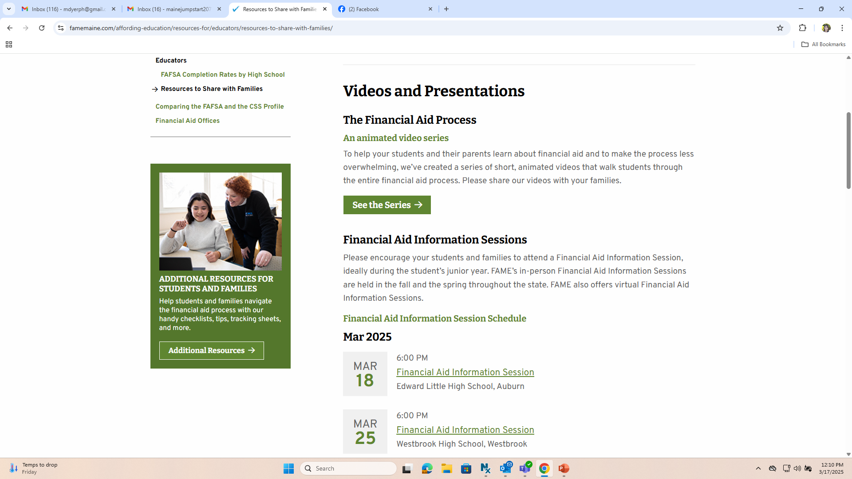
Did You Know?
FAME has postcards, posters, and sample scripts that you can use to promote FAFSA completion?
Notes:
We’ve been asked for videos, scripts that folks can plug/play

Slide 11
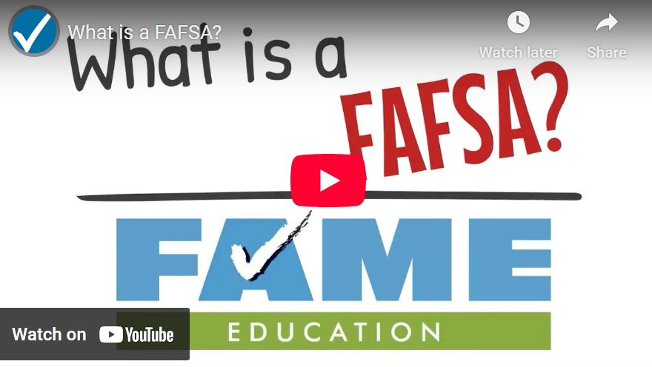
Did You Know?
FAME has animated explainer videos on a variety of topics?
Notes:
We also provide follow up scripts to use when contacting students about their FAFSA completion status.

Slide 12
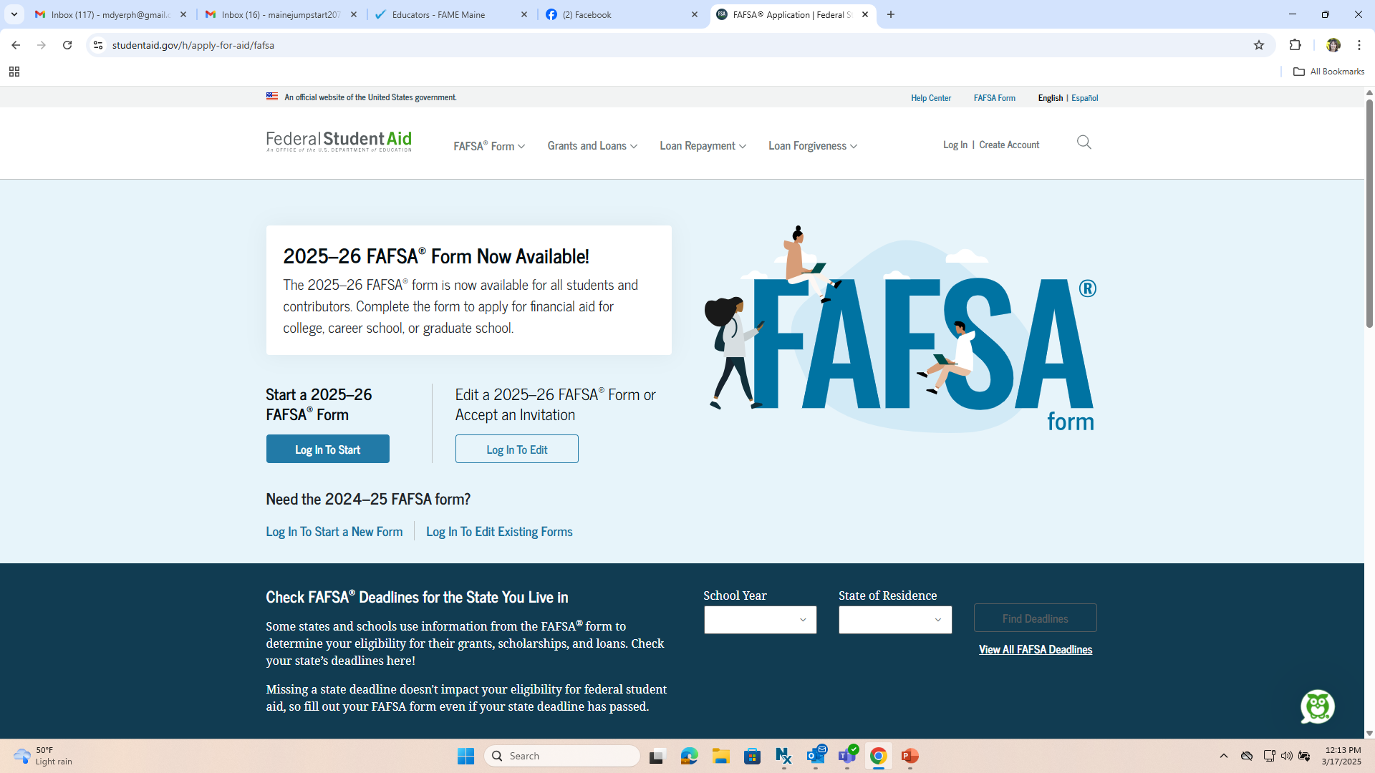
Did You Know?
FAME offers a FAFSA portal for schools and publishes FAFSA completion rates by school?

Slide 13
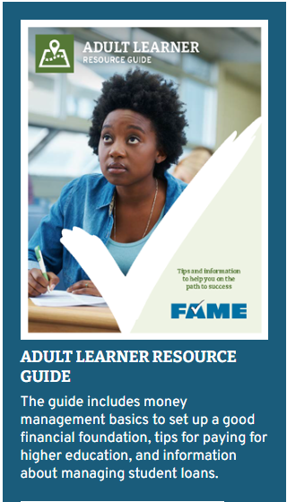
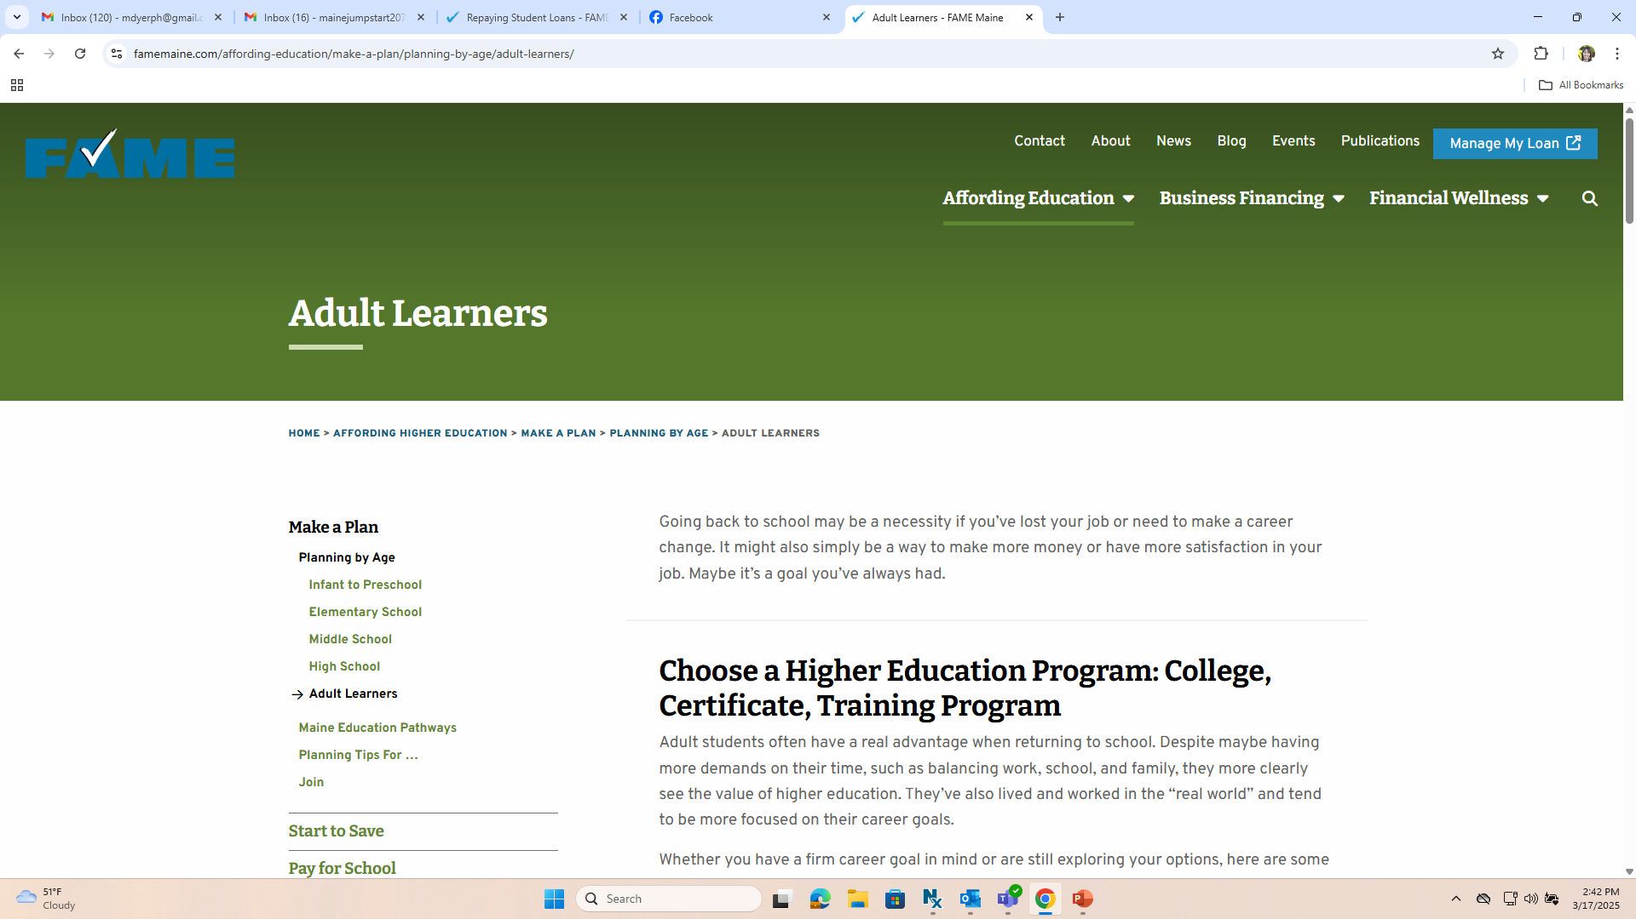
Did You Know?
FAME has a partnership with adult education to provide financial wellness and financial aid workshops?

Slide 14
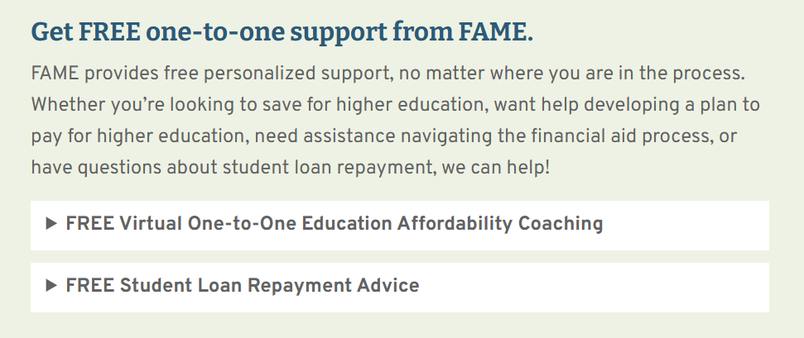
Did You Know?
FAME offers FREE one-on-one Education Affordability Coaching AND Student Loan Email Counseling?

Slide 15
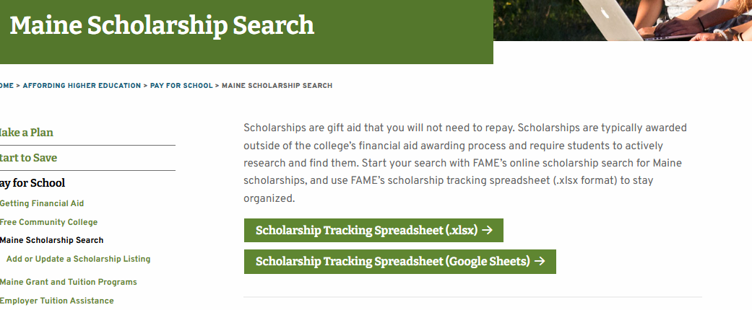
Did You Know?
FAME offers a Maine-based scholarship
search tool?

Slide 16

Did You Know?
FAME has a webpage for new Mainers and a credentialing grant?
Floreka Mananga
New Maine Specialist

Slide 17
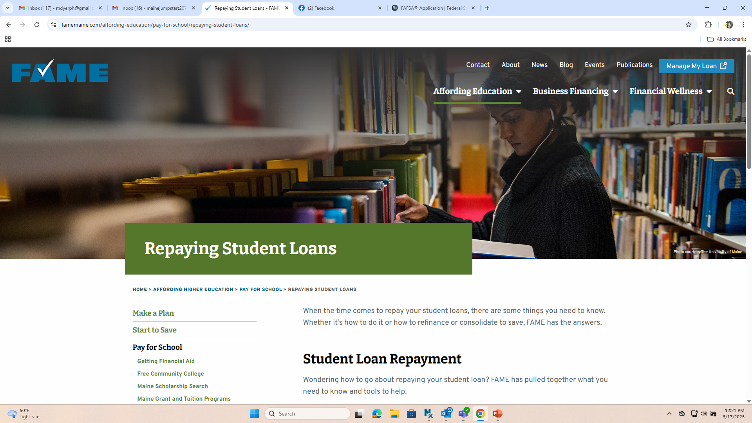
Did You Know?
FAME has extensive information to support student loan repayment and informed borrowing?

Slide 18


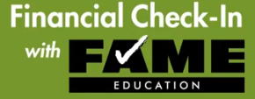
Did You Know?
FAME offers financial wellness programs and resources for K-12 students, adults, and employers?

Slide 19
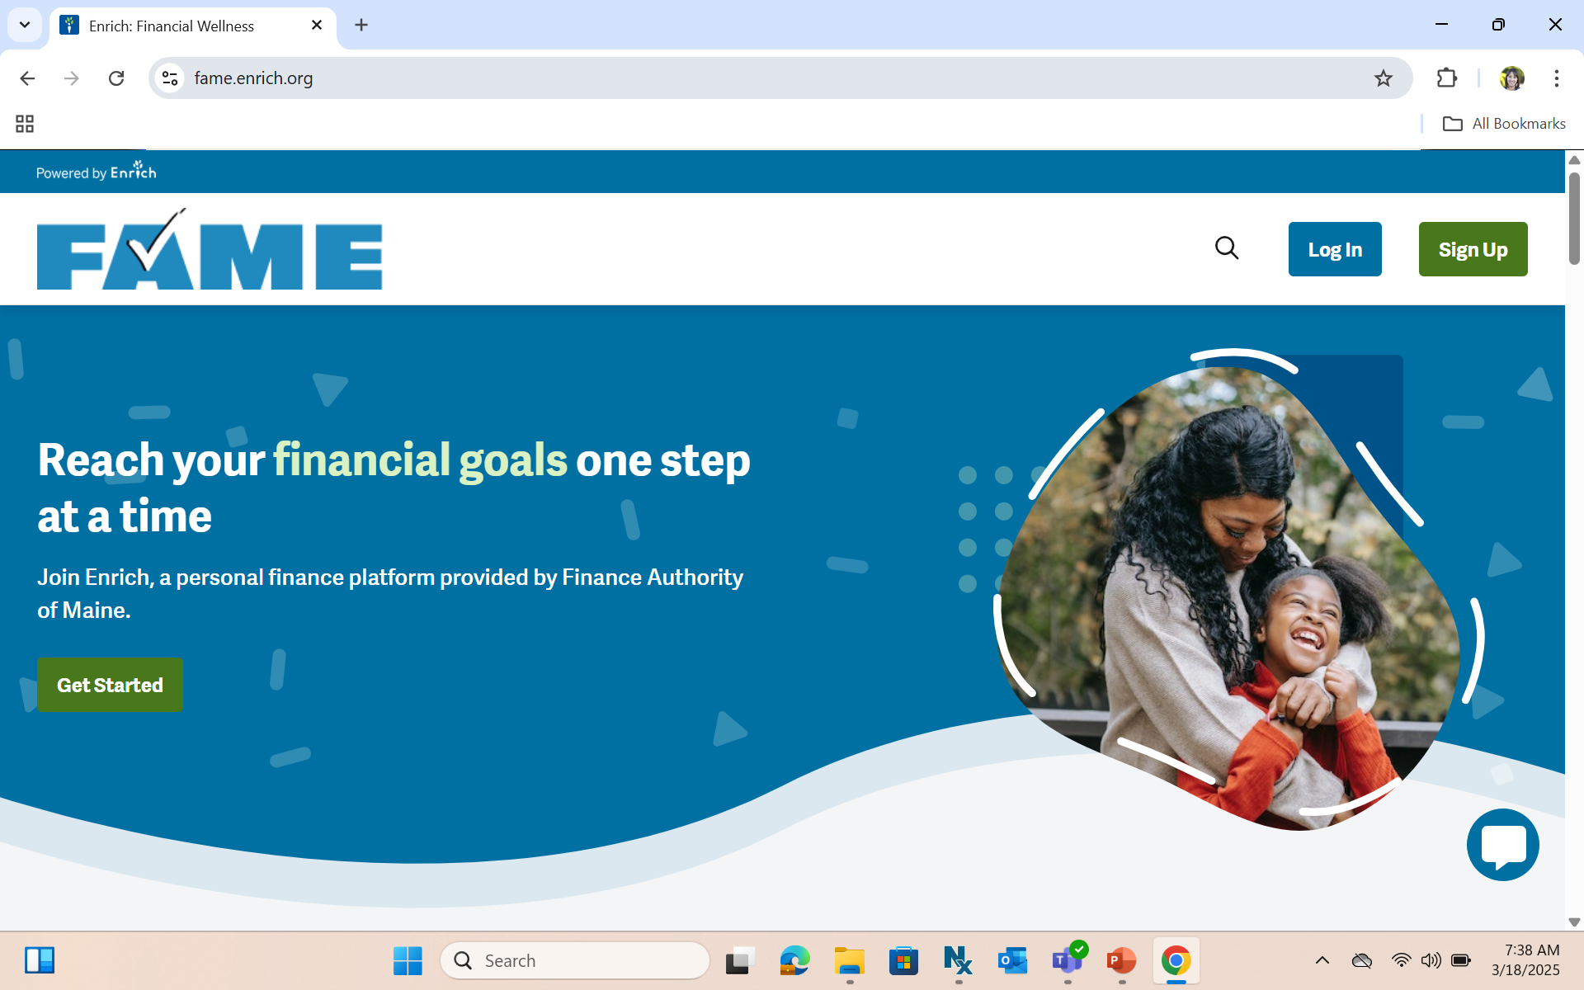
Did You Know?
FAME has a FREE online financial wellness platform for high school, higher education, and beyond?

Slide 20
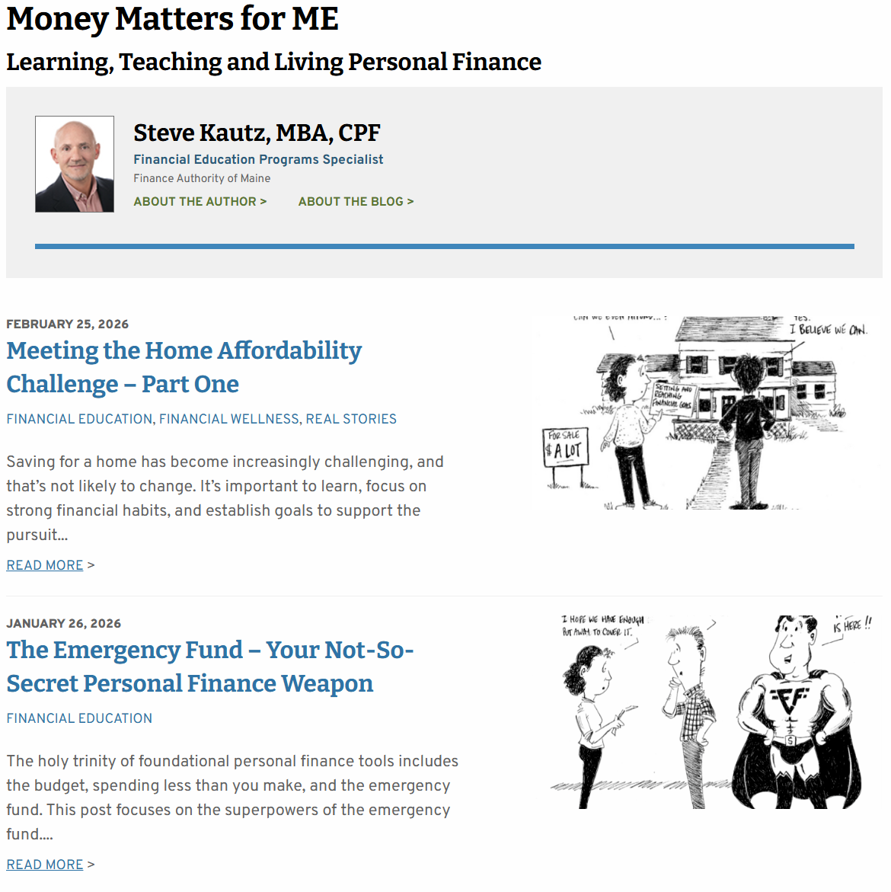
Did You Know?
FAME has a financial wellness blog for professionals?

Slide 21



Did You Know?
FAME distributes financial wellness books to 84,000 elementary students each year?

Slide 22
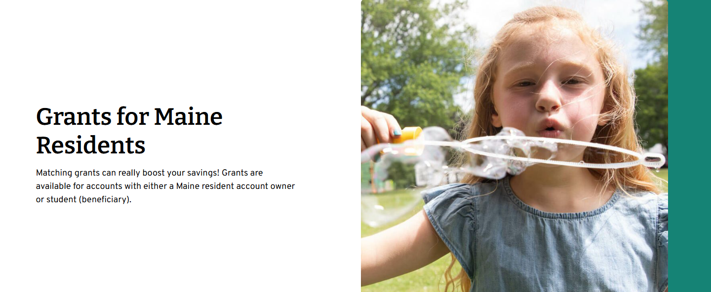
Did You Know?
FAME offers grants to help Maine families save for higher education?

Slide 23



Did You Know?
FAME has specialized calculators to help with setting up a plan to pay for higher education?
529 Plan State Tax Deduction Calculator
Benefits of Saving Calculator
Goal Setting Calculator

Slide 24

Did You Know?
FAME’s Education Affordability and Financial Wellness team offer school and community outreach across the state?

Slide 25
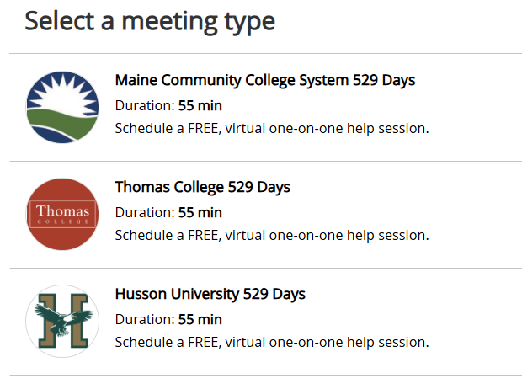
Did You Know?
FAME’s Education Affordability and Financial Wellness team offers employer/organization specific education savings or financial aid support?

Slide 26
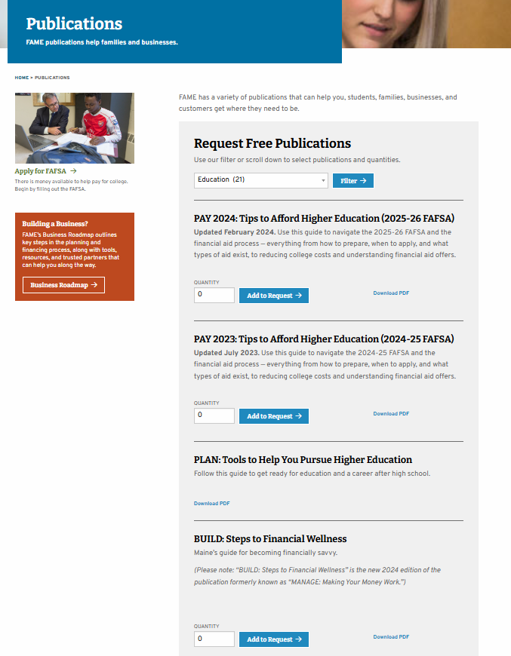
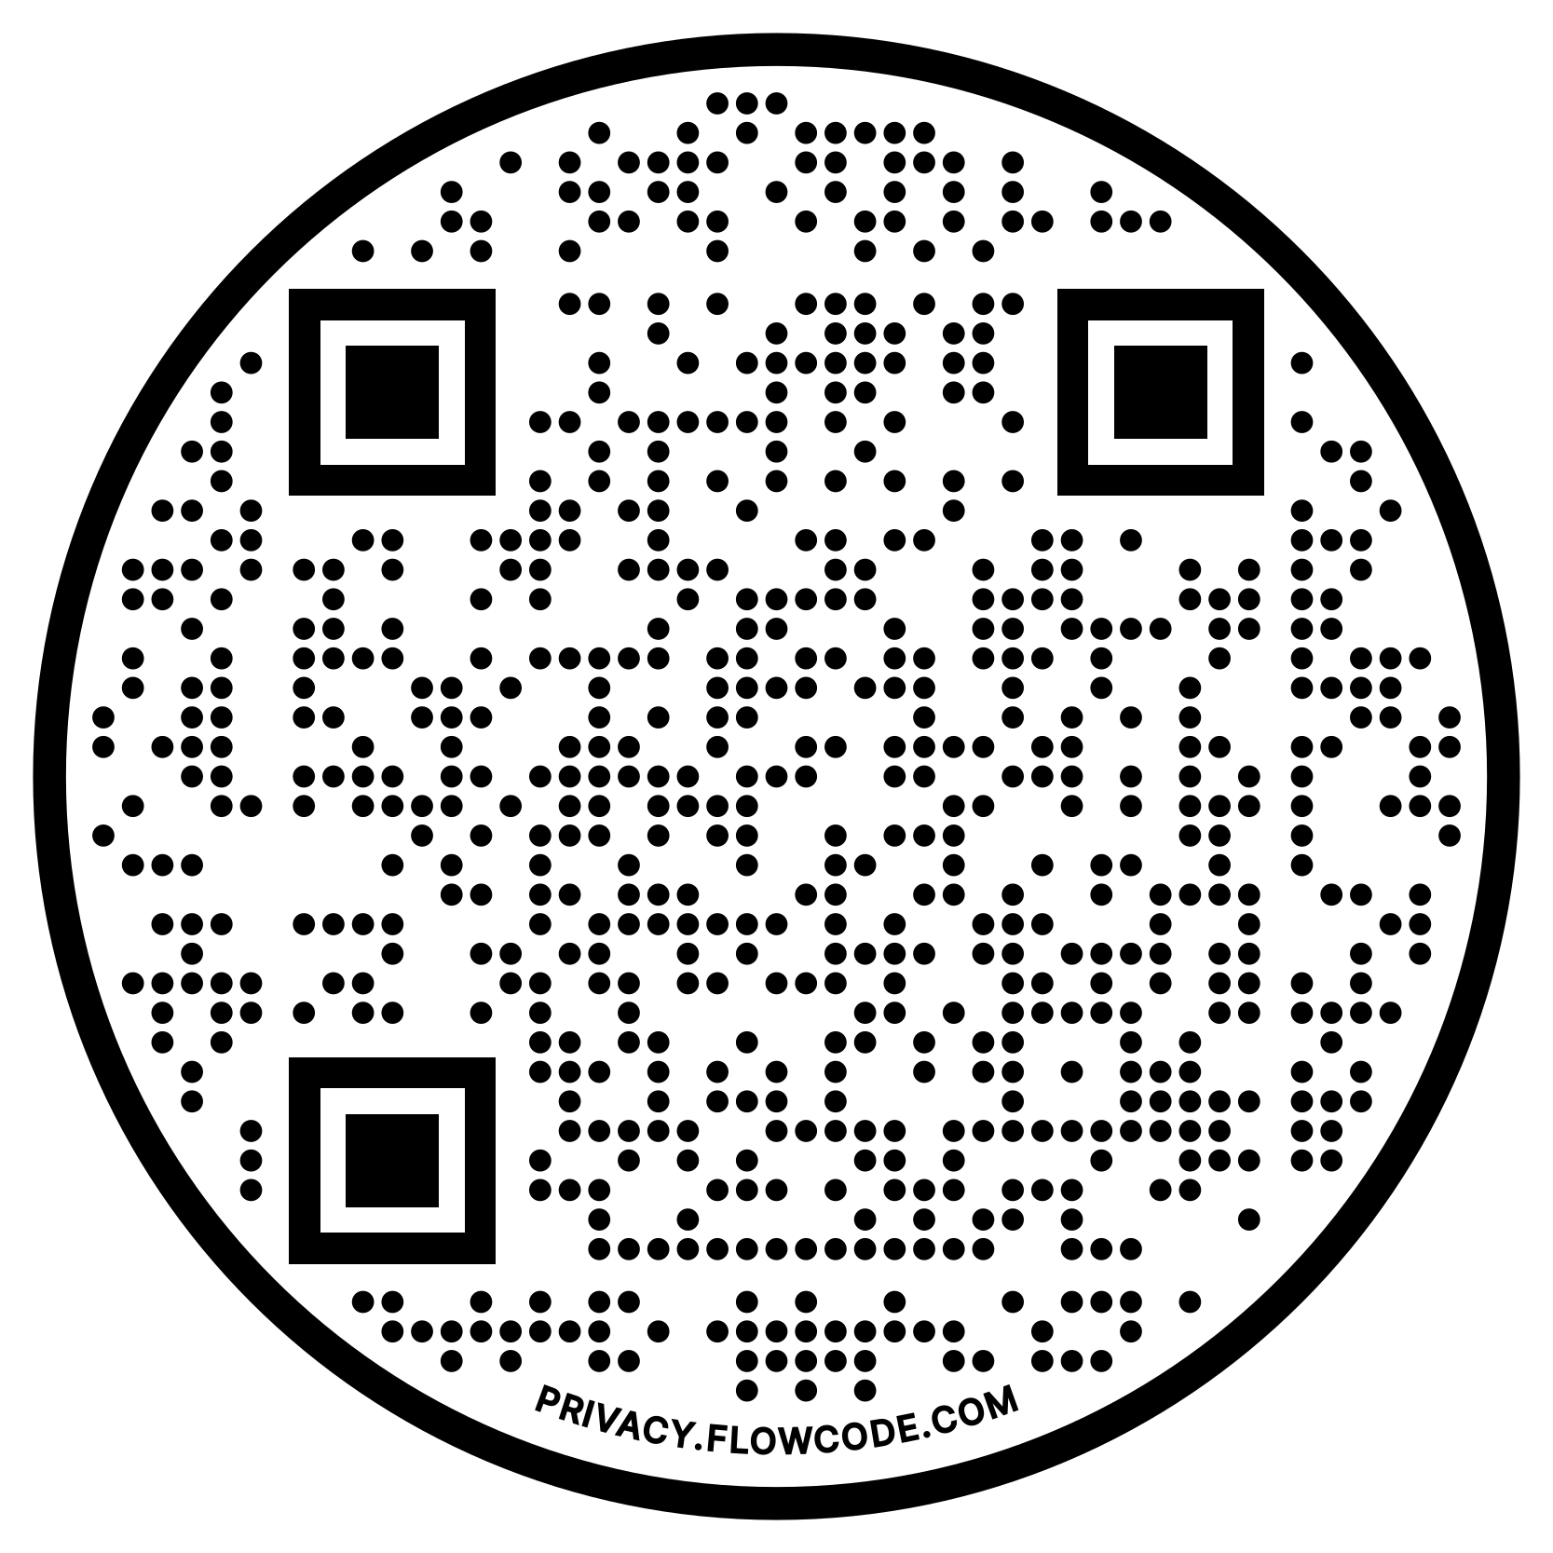
Did You Know?
You can download and order FREE publications from FAME?
Scan to Order Your Materials Today

Slide 27
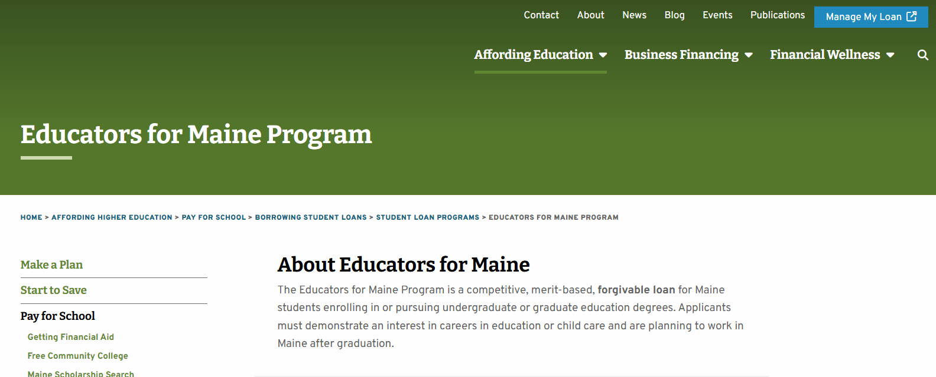
Did You Know?
FAME offers a merit-based forgivable loan for Maine students pursuing degrees in education?

Slide 28

Did You Know?
FAME offers private Loans for Maine students and families?

Slide 29
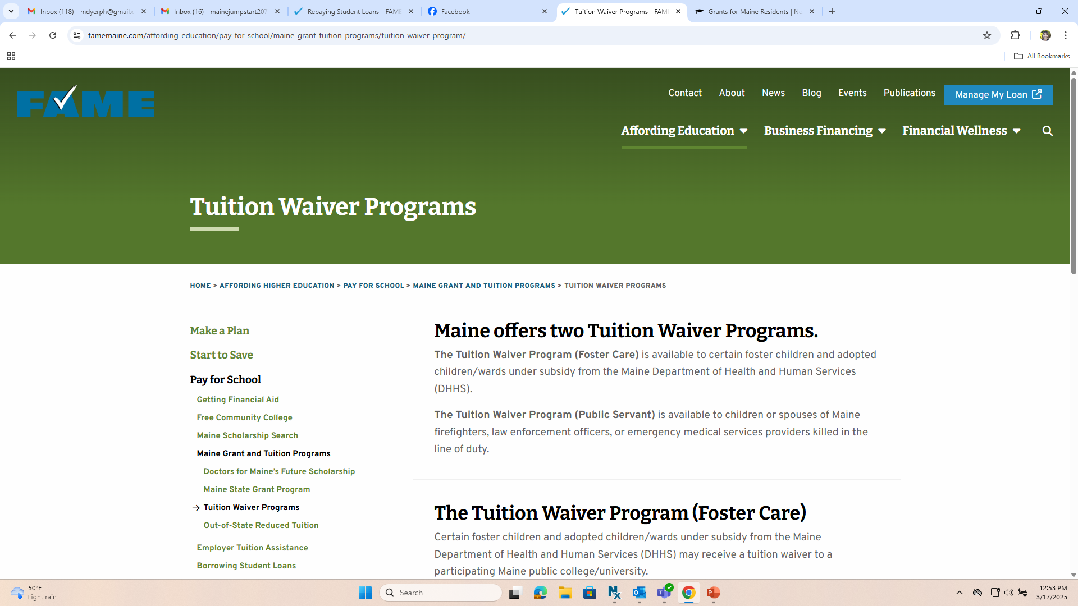
Did You Know?
FAME administers a tuition waiver program for children in foster care and children/spouses of ME firefighters, law enforcement officers, or EMS providers killed in the line of duty?

