Slide 1
Resources for New Mainers
January 8, 2025
PRESENTED BY
Floreka Malual New Mainer Specialist
Mila Tappan Manager of College Access and Outreach

Slide 2
Today’s Agenda
Free Higher Ed and Work Force Training
  Free Community College
  Harold Alfond Center for the Advancement of Maine’s Workforce
  Eastern Maine Development Corporation’s Workforce Development Services
FAME’s New Mainer Section
  Getting Ready
  Paying for College
    Parents without SSN#
    Scholarships
  Foreign Credentialing and Skills Recognition Grant Program
  New Mainer Resources
  FAQs
  Other Resources
Notes:
Mila

Slide 3
Tuition-Free Community College
What is the free community college initiative?
Provides two years of tuition-free community college to the Maine high school graduates in the Classes of 2022, 2023, 2024, and 2025.
100% of tuition and mandatory fees are covered at any one of the seven colleges across the state.
Tuition and fees are covered by the Free College Scholarship unless the student’s tuition and fees are already covered by a Federal Pell Grant and/or Maine State Grant.

Slide 4
Tuition-Free Community College
To qualify, students must:
Have a high school diploma or equivalent. This includes home schooled students, and students earning a GED or Hi-SET during those years.
Pursue an associate degree or academic credential
Live in Maine at the time of enrollment and while enrolled in the program
Accept all federal and state grants
  Eligible students need to file a FAFSA to see if they are eligible for a Pell Grant and/or a Maine State Grant.

Slide 5
Tuition-Free Community College
What if the student is not eligible for federal student aid? Are they eligible for the Free College Scholarship?
Yes – students not eligible for federal student aid are eligible for the Free College Scholarship.
Students do not need to file a FAFSA!
Instead, the student needs to contact an advisor at the community college they plan to attend.
  The advisor will document their circumstances and notify the appropriate campus offices.
Notes:
Mila
Mention that this is also the case for dependent students who are eligible for federal student aid but who are unable to obtain parent information.

Slide 6
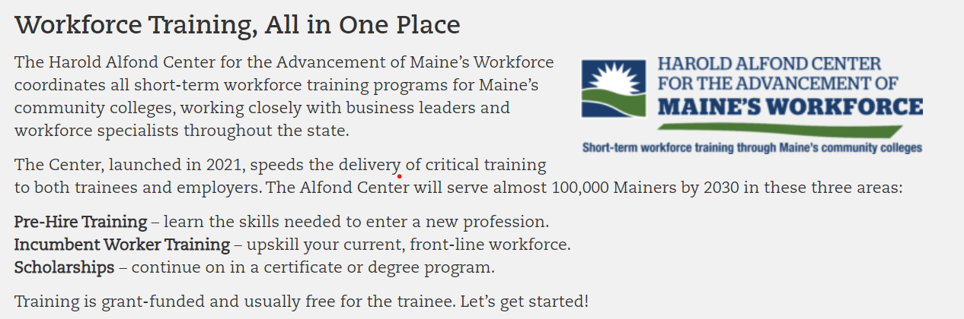
Harold Alfond Center for the Advancement of Maine’s Workforce

Slide 7


Harold Alfond Center for the Advancement of Maine’s Workforce
Learn more at: mccs.me.edu/workforce-training/for-trainees/non-credit-courses/

Slide 8
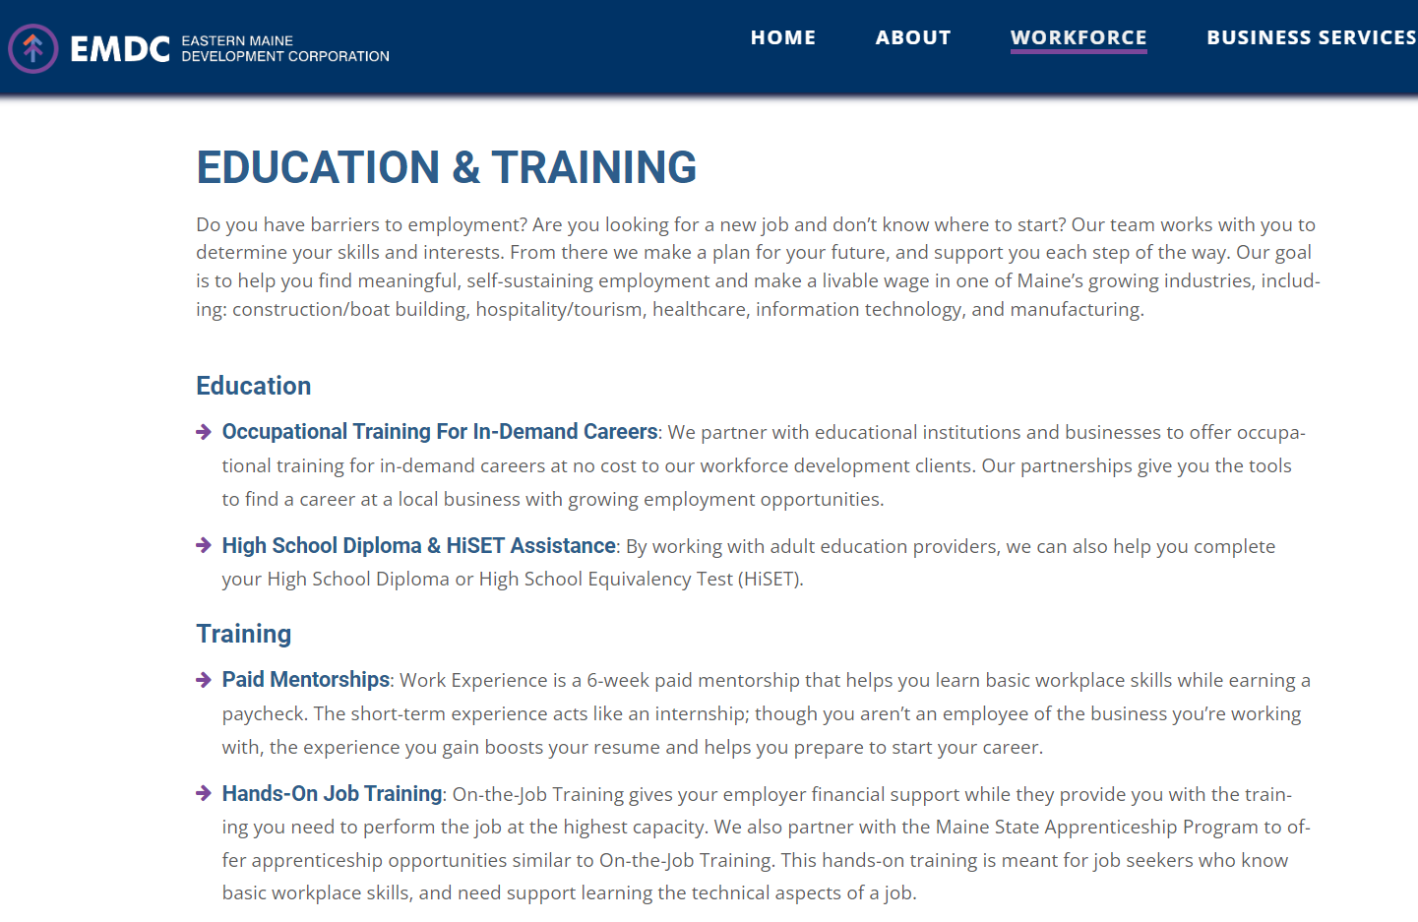
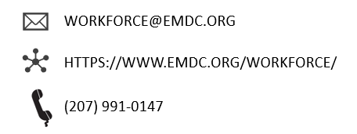
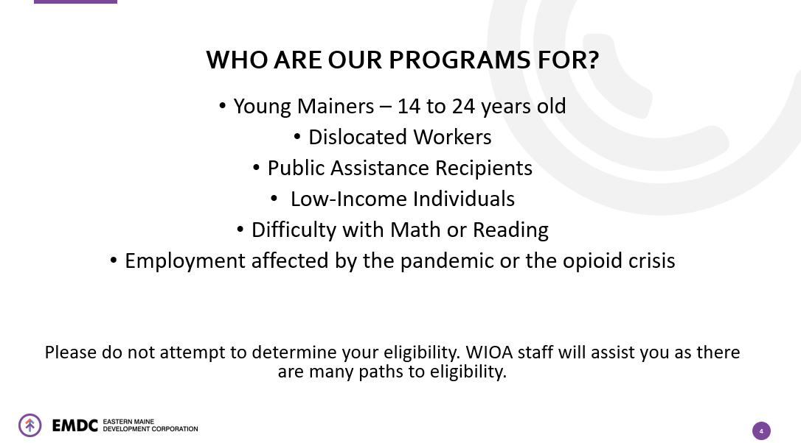
Eastern Maine Development Corporation (EMDC)

Slide 9
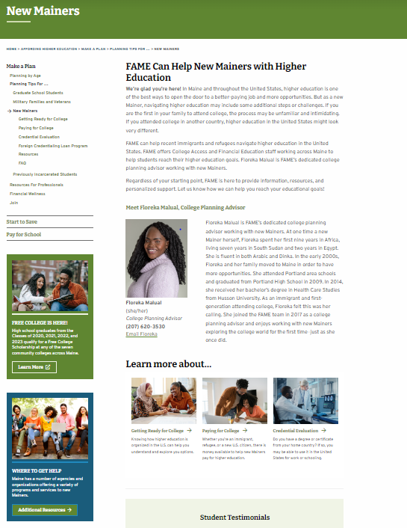
New Mainer Website
Welcome to FAME’s New Mainers Website
Meet Floreka!
Get Ready for College
Paying for College
Credential Evaluation
Resources
FAQ
How Floreka Can Help!
FAMEmaine.com/newmainers

Slide 10
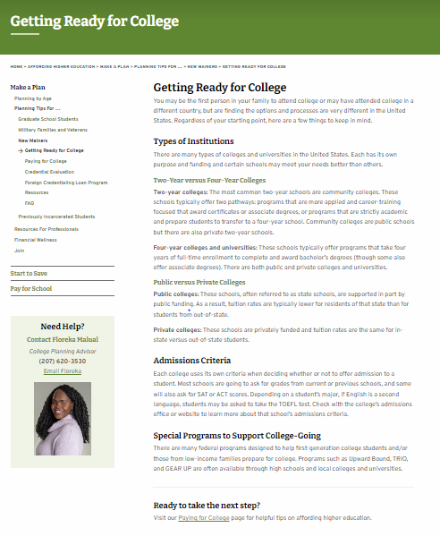
Getting Ready for College
College Going Information
Higher education is structured very differently in the U.S. than in other countries.
There are great programs to support college going students!
Talent Search
Upward Bound
Student Support Services

Slide 11
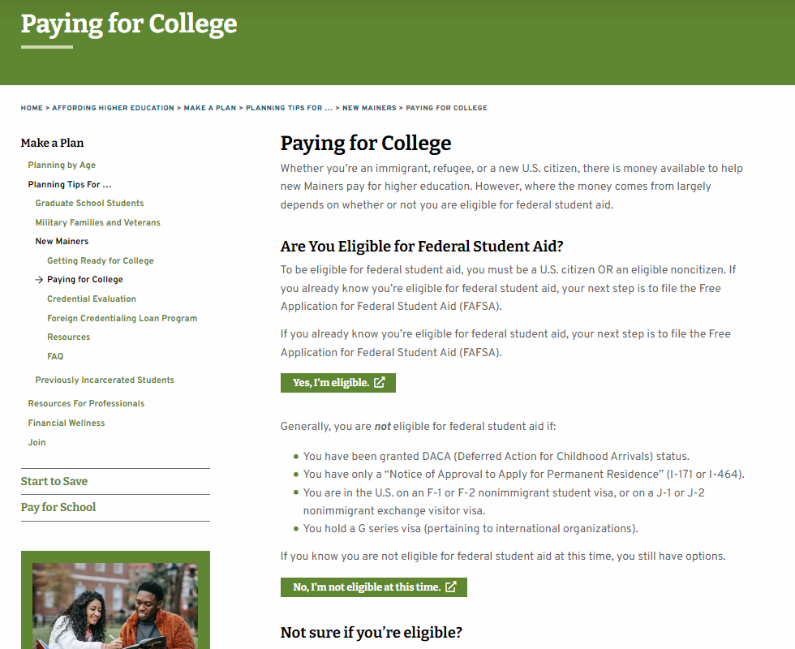
Paying for College
Federal Student Aid Eligibility Determination

Slide 12
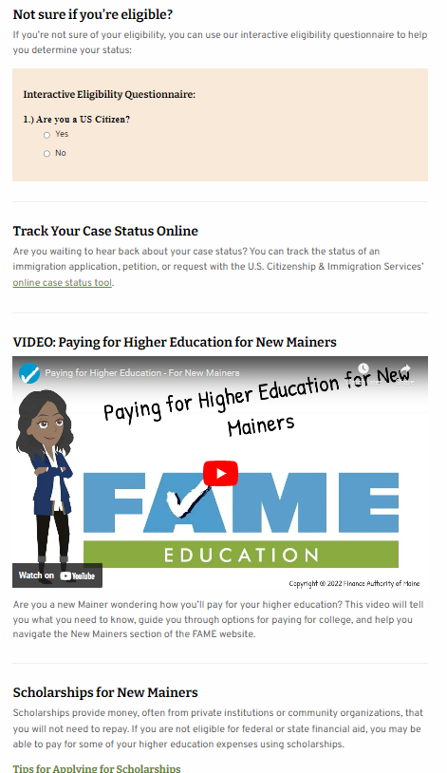
Paying for College
Helpful Tools
Tracking Status of Immigration Application
Paying for Higher Education Video
Scholarships for New Mainers

Slide 13
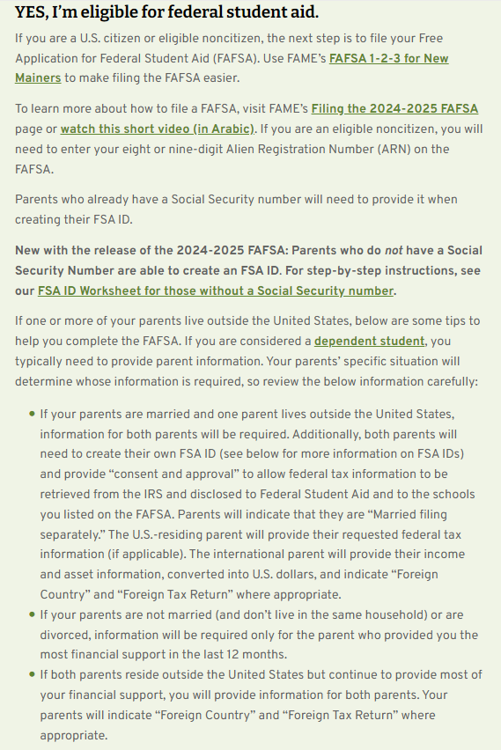
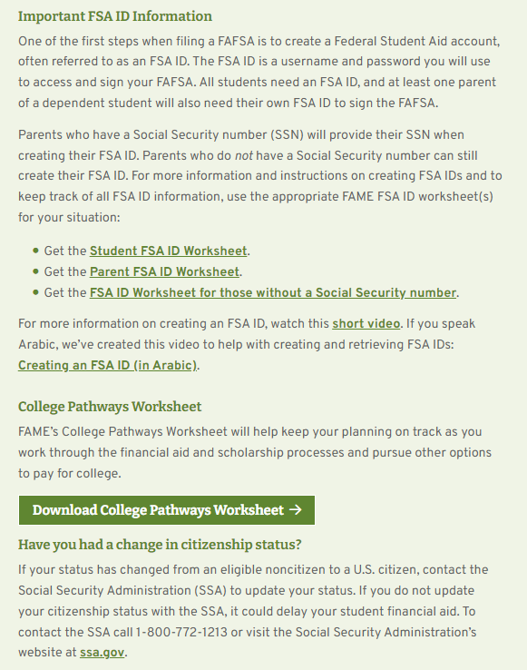
Paying for College
Yes, I’m eligible for federal student aid!
FAFSA tips for new Mainers
FSA ID information and resources
Pathway worksheet

Slide 14
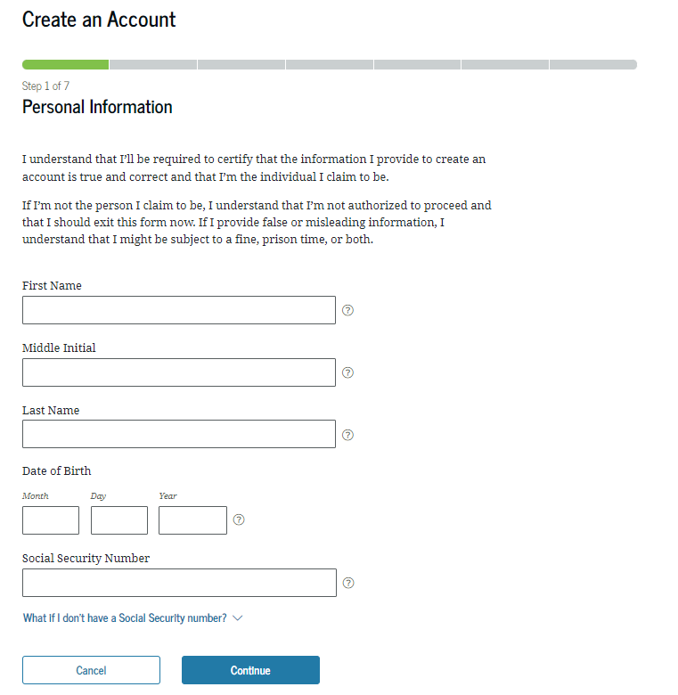
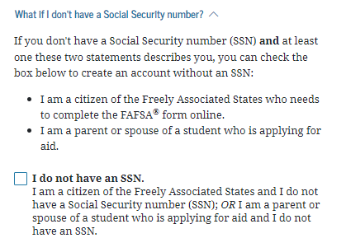
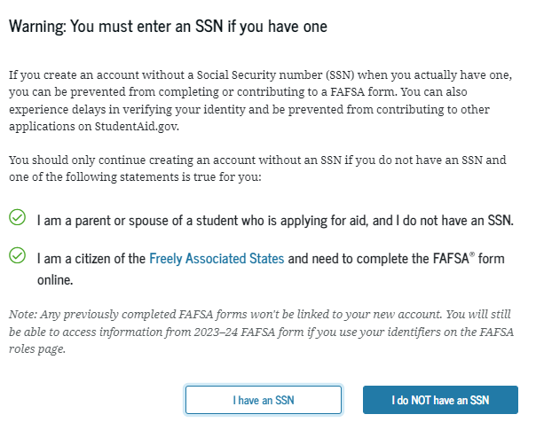
Parents Without Social Security Number
Students must have a regular SSN (not one for work purposes only) and be a citizen or eligible non-citizen).
Parents without a Social Security number (SSN) must create a StudentAid.gov account (FSA ID) to access, complete and sign their portion of the FAFSA.

Slide 15
Parents Without Social Security Number
The remainder of the FSA ID creation process similar process for those w/ an SSN except that individuals must certify their identity by checking a box. Additionally, some individual will see knowledge-based verification questions.
When the account is created, the confirmation screen will inform the individual of their verification status.
  If the account is verified, individuals can immediately begin fully using their account.
  If the account is created, but not verified, individuals will be able to access the FAFSA form, but the account will have limited functionality. No additional steps are currently needed.
For step-by-step instructions to create an account without a SSN, see our FSA ID Worksheet for those without a Social Security number

Slide 16
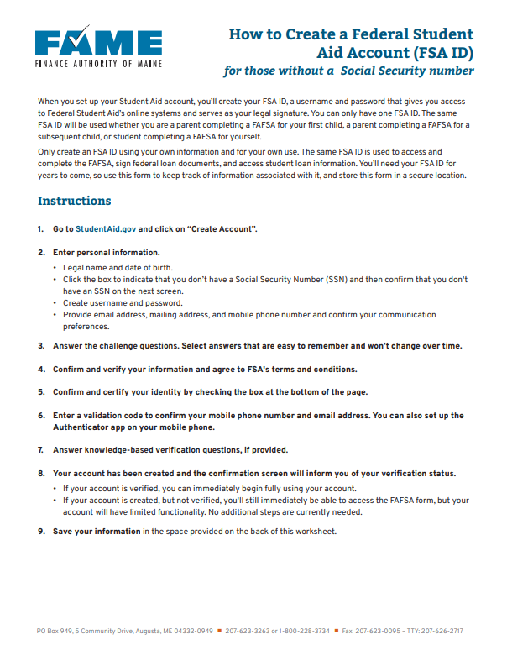
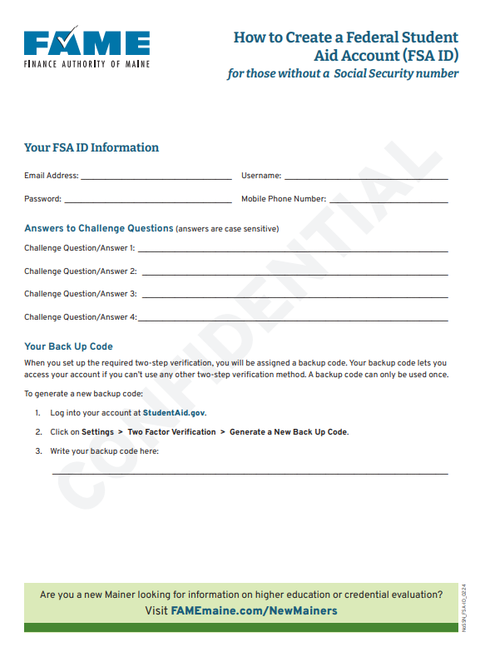
Parents Without Social Security Number
Form has been updated to reflect recent guidance from FSA
Notes:
Mention that email will now be generated automatically if they don’t see or aren’t able to correctly answer the identity verification questions.

Slide 17
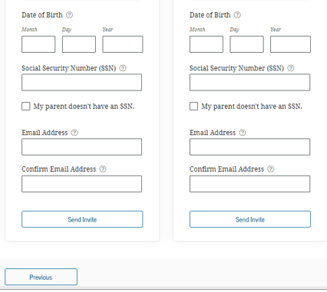
Parents Without Social Security Number
In the FAFSA…
When completing the invitation section there’s a box to indicate parents don’t have an SSN.
When box is checked, screen will update to display request for mailing address.
No longer will parents without an SSN fill in all zeros in the SSN box.

Slide 18
Parents Without Social Security Number
Remaining issues for mixed-status families (student has SSN but parent does not):
IRS match is not working for anyone without SSN
  Contributors will need to manually enter tax return related data.
If the student enters slightly incorrect information when inviting contributor, system is having trouble finding the contributor so can’t send an invitation.
  If the student starts the FAFSA and the invite isn’t working, have the student delete their section of the FAFSA and have the parent start the FAFSA.

Slide 19
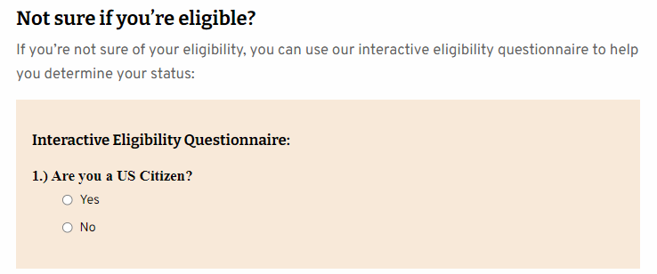
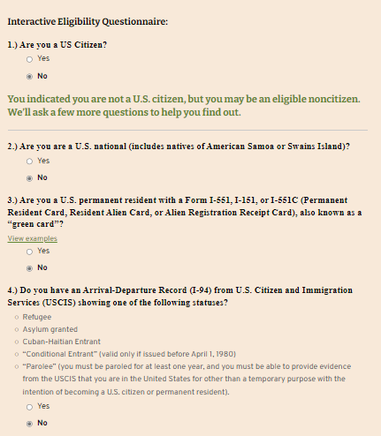
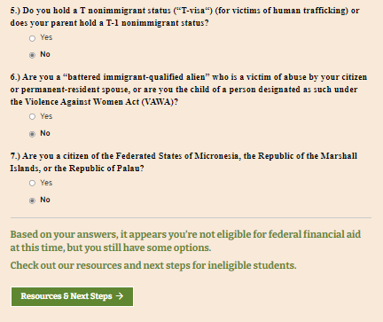
Paying for College
Not sure if eligible for federal student aid!
Use this tool!
Notes:
Floreka
But what if a student isn’t sure if they are eligible for federal student aid?
Skip logic will walk them through these questions. They will see one at a time. If the answer to a question is yes, they will see the link to the “Eligible for Federal Student Aid” content we shared on the previous screen.
If they answer no, they will see additional questions. If all 7 are “no” then they will see the “Resources & Next Steps” link.

Slide 20
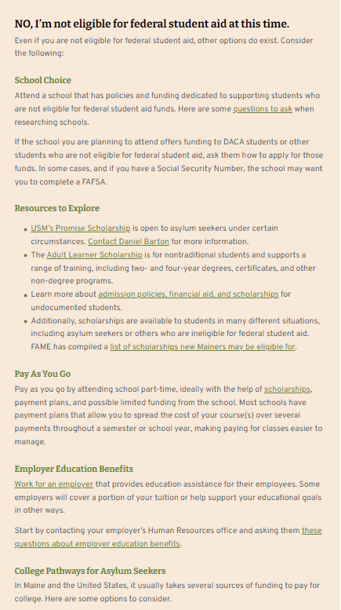
New Mainer Website –
Paying for College
Paying for College
Not Eligible for Federal
Student Aid
School Choice
Resources to Explore
Pay As You Go
Employer Educations Benefits

Slide 21
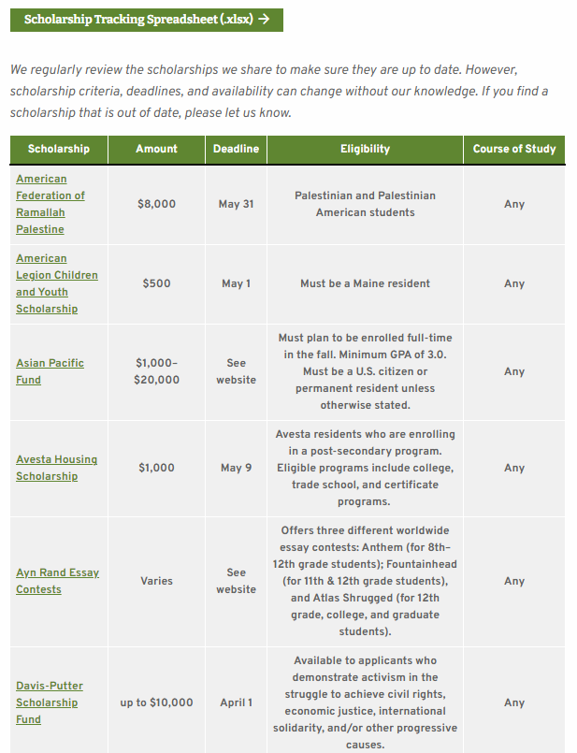
Scholarships for New Mainers
Check out those listed in the New Mainer section
Also connect with the following to ask about scholarships:
Local high school or guidance office
College financial aid office
Employer/parent employer
Faith based institutions
Local service organization

Slide 22
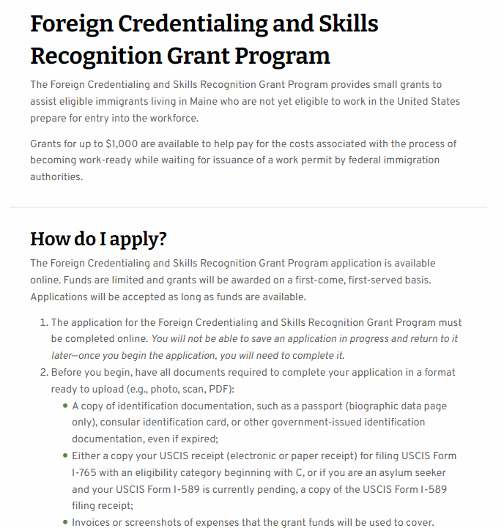
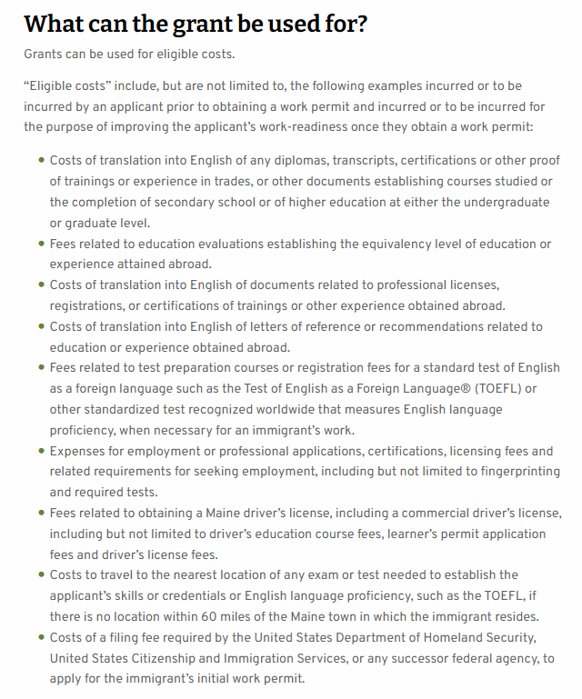
Foreign Credentialing and Skills Recognition Grant Program
Foreign Credentialing and Skills Recognition Grant Program
Grants for up to $1,000 are available to help pay for the costs associated with the process of becoming work-ready while waiting for issuance of a work permit by federal immigration authorities.
Funds are limited – first come, first served
Notes:
Floreka

Slide 23
Local Organizational Resources for New Mainers
Gateway Community Services
Hope Acts
Learning Works
Maine Youth Action Network
My Place Teen Center
New Mainers Resource Center
Portland Adult Education (PAE)
Portland Public Schools: Multilingual and Multicultural Center
Prosperity Maine
The Root Cellar
Tree Street Youth
Youth & Community Engagement

Slide 24
Frequently Asked Questions (and Answers)
Am I eligible to receive federal student aid?
As an eligible noncitizen, is there any additional information I need to provide when completing the FAFSA?
As an undocumented student or DACA student, can I file the FAFSA?
As an eligible noncitizen, what will I need to complete the FAFSA?
One or both of my parents live outside of the United States. Do I need to include their financial information?
How do you represent income from a foreign tax return?

Slide 25

How Floreka Can Help!
One-on-one appointments
Classroom presentations
College application assistance
Scholarship application assistance
Credential evaluation grant application help
Navigating resources and more

Slide 26

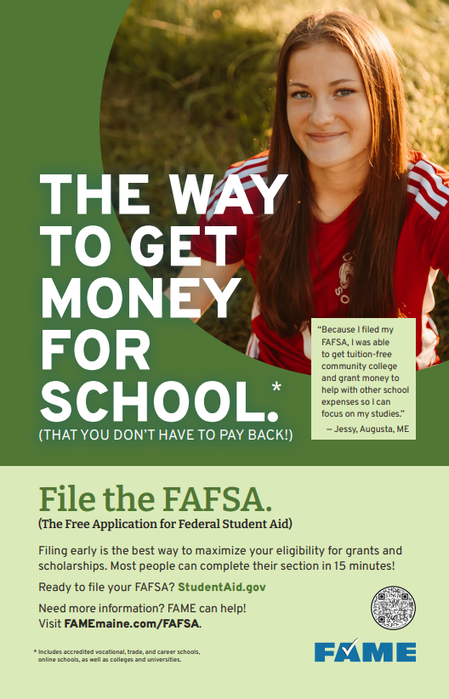
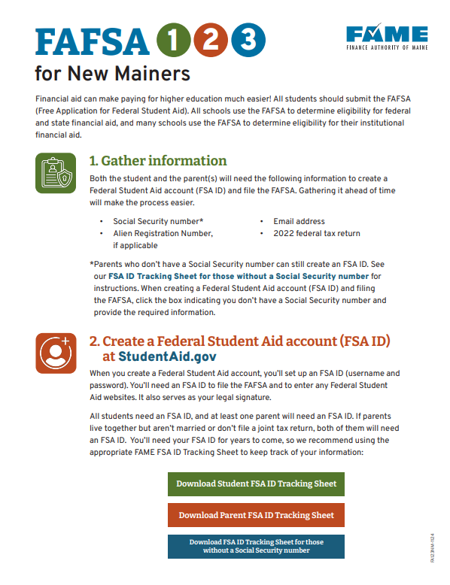



Other FAME Resources

Slide 27
Questions?

Slide 28

Thank you for joining us today! Find more FREE resources and information at FAMEmaine.com/education
Follow us:
Contact: education@FAMEmaine.com
PH: 207-623-3263 or 800-228-3734
TTY: 207-626-2717

